Slide 1
Mechanism Design for Auction and Matching
CS6382
Slides by Taiki TODO

Slide 2
Today’s Agenda
Basics of Game Theory and Mechanism Design
Auction (Single-Item and Combinatorial)
Matching (One-to-One and Many-to-One)

Slide 3
Basics of Game Theory and Mechanism Design

Slide 4
Basic terms
Player: an agent who makes his decision, for a while, we assume there are two players
Action: the choice of a player, for a while, we assume a player makes his decision simultaneously, and only once
Utility: the value given for each player based on the combination of players’ actions; a larger value is better.

Slide 5
Pareto Efficiency
Definition: A state is said to be Pareto efficient, iff there exists no state that is
better for at least one agent, and
no worse for all the rest
×
Movie | 2 | 2 | 2
Shopping | 2 | 2 | 5
Zoo | 2 | 3 | 1
Home | 1 | 1 | 1
×
Notes:
Pareto efficiency is one characteristic that socially optimal state should satisfy.
The definition is that, a state is said Pareto efficient, iff there exists no other state that is
better for at least one agent, and
no worse for all the rest.
Assume a situation that a family, a father, a mother, and a child, wants to decide what to do on the weekend. These values represent their utilities. Clearly, staying home is not Pareto efficient. Also, going to the movie is not Pareto efficient since everybody prefers going shopping.
On the other hand, going shopping and going to the Zoo, both are Pareto efficient and we cannot eliminate the possibilities further.

Slide 6
Pareto Efficiency (cont’d)
Divide $1000 between you and me.
We can throw away some.
(0, 1000), (x, 1000-x), (1000, 0), all are Pareto efficient.
We can agree on (250+x, 750-x) is better than throw away $500 and get (250, 250).
Notes:
２つのエージェント，u1,u2はそれぞれエージェント１，２の利得．可能な行動の組み合わせに関して，エージェントの利得の組み合わせをプロットしたもの
右上の境界がパレート最適

Slide 7
Pareto Efficiency (cont’d)
In principle, it is not clear whether we can compare utilities of different people.
Do we really have a common measure (e.g., money)?
The definition of Pareto efficiency can be applied even if we cannot compare utilities.
We can consider Pareto efficiency is a minimal requirement of a desirable social choice.
If x is not Pareto efficient, then there is another choice x’, where everybody prefers x’ to x (or at least the same).

Slide 8
Characteristics of Player
Risk neutral/averse
risk neutral： only cares the expected utility
e.g., indifferent between two lotteries: 1) he/she obtains 0 for the head and $100 for the tail, 2) he/she obtains $50 for sure.
risk averse： prefers an outcome that is more certain （even with less expected utility）
e.g., prefers getting $45 for sure to 1.
Notes:
First, let me describe the attitude towards risks of agents.
A risk neutral agent only cares the expected utility
e.g., he is indifferent between two lotteries: 1) he/she obtains 0 for the head and $100 for the tail, 2) he/she obtains $50 for sure.
On the other hand, a risk averse agent prefers that is more certain （even with less expected utility）
e.g., prefers getting 45 for sure to 1.
Most people are risk averse, since people buy insurance. The expected cost for having a car accident is certainly lower than the price of the insurance. However, I’m more comfortable to buying the insurance so that eliminating the risk of paying a very high cost if I have a car accident.
At the same time, some people buy a lottery ticket. Cleary, the expected utility is lower than the price of the ticket. In this case, people prefer the risk.
In the rest of this talk, we basically assume an agent is risk neutral, since this case is much easier to handle.

Slide 9
The St. Petersburg Paradox
Assume the following lottery...
Flip a coin, if it comes up tail, you get $2.
If head, flip a coin again, if it comes up tail, you get $4.
If head, flip a coin again, ....
If it comes up tail the first time at n-th trial, you get $2^{n}.
How much are you willing to pay to participate in this lottery?
Notes:
The quasi-linear and risk-neutral assumptions sound OK, but we can create a very weird situation.
This is called St. Petersburg Paradox.
Flip a coin, if it comes up tail, you get $2.
If head, flip a coin again, if it comes up tail, you get $4.
If head, flip a coin again, ....
If it comes up tail the first time at n-th trial, you get $2^{n}.
How much are you willing to pay to participate this lottery?

Slide 10
The St. Petersburg Paradox
Why don’t we want to pay just $10 for the lottery with an infinite expected utility?
Attitude toward risks: a human is risk-averse, even with a small expected value, he/she prefers a sure thing. This lottery is too risky.
If one can join this lottery multiple times, and the price is $10, one should try many times.
The utility does not grow linearly when the amount becomes too large; there is not much difference between $1billion and $2billion.

Slide 11
Assumption
Quasi-linear utility: an agent’s utility is defined as the difference between its evaluation value of the allocated good and its payment.
If an agent wins a good whose evaluation value is $100 by paying $90, its utility is $100-$90=$10.
If it does not win, its utility is $0.
If it does win, paying $100, its utility is 0.
Notes:
Also, we introduce some assumptions for simplicity.
A commonly used assumption for simplicity is Quasi-linear utility, which means that an agent’s utility is defined as the difference between its evaluation value of the allocated goods and its payment.
For example, if an agent wins a good whose evaluation value is $100 by paying $90, its utility is $100-$90=$10.
If it does not win, its utility is $0.
Also, if the agent wins by paying $100, its utility is also $0.
We can assume this assumption is reasonable if the price is not too high.

Slide 12
Social Surplus – Another Measure
Assuming agents’ utilities are quasi-linear, if a state is Pareto efficient, the social surplus (sum of all agents’ utilities) must be maximized.
×
6
9
6
3
Movie | 2 | 2 | 2
Shopping | 2 | 2 | 5
Zoo | 2 | 3 | 1
Home | 1 | 1 | 1
→3
→4
×
×
Notes:
By introducing the assumption that preferences are quasi-linear, now, agents can transfer their utility by money.
Therefore, if a state is Pareto efficient, the social surplus (sum of all agents’ utilities) must be maximized.
In the previous example, both shopping and Zoo are Pareto efficient. However, since agents can transfer money, say, this mother promises to the child, if he is willing to go shopping, she will buy a new toy, the utility can be changed this way.
Here, the only Pareto efficient choice is to go shopping, which maximizes the social surplus.

Slide 13
Desirable Properties of a Group Decision Making
For each agent, there exists a dominant strategy (or at least a simple strategy that constitutes a Bayesian Nash equilibrium).
The mechanism is robust against various frauds (e.g., spying).
A Pareto efficient outcome can be achieved.
Notes:
Now, let me describe several desirable properties a group decision making mechanism should satisfy.
One is, for an agent, there exists a dominant (best) strategy. If there exists a dominant strategy, an agent does not need to worry about the actions of other agents.
Also, the mechanism is robust against various frauds (e.g., spying).
Another property is that the obtained allocation is Pareto efficient.
Let me describe more detail about a Pareto efficient allocation in the next slide.

Slide 14
Mechanism/Market Design
Designing a mechanism is determining the rules of a game.
The designer cannot control the actions of each agent.
No way to force an agent to be honest or to refrain from doing frauds.
Notes:
Now, let’s think about what is the meaning of designing a group decision making mechanism using the terms and concepts described so far.
Designing a protocol is determining the rules of a game.
Although the designer can determine the rules of the game, the designer cannot control the actions of each agent.
There is no way to force an agent to be honest or to refrain from doing frauds.
The agents will break rules if breaking rules is profitable for them.
Therefore, it would be difficult to predict the results of the game or the auction.

Slide 15
Mechanism/Market Design
How can a designer achieve a certain desirable property (e.g., Pareto efficiency)?
Design rules so that:
For each agent, there exists a dominant strategy.
In the dominant strategy equilibrium, the desirable property is achieved.
Notes:
Then, how can a designer achieve a certain desirable property (e.g., Pareto efficiency)?
Actually, the designer can achieve the goal by designing the rules so that:
For each agent, there exists a dominant strategy.
And if everybody takes the dominant strategy, this situation is called dominant-strategy equilibrium, the desirable property is achieved.
In short, if the designer can design the rules so that following the rules is profitable for each agent, the designer can make sure that the participants will follow the rules.
In reality, it is not always possible to achieve a desirable goal, but in some cases, we can.
Assume a government is allocating some public asset, say, the right to use radio frequency to some company. The goal is to allocate the asset to the company who has the most advanced technology to utilize it. If we use the Vickrey auction, every company declare its true evaluation value. Thus, we can allocate the frequency to the company who has the highest evaluation value, namely, the company should have the most advanced technology.

Slide 16
Auction (Single-Item and Combinatorial)

Slide 17
Theory of Auctions
For seller:
The behaviors of bidders change according to the auction protocol.
can give a protocol that can achieve socially desirable outcome or robustness against cheating.
For bidders:
The best strategy changes according to the auction protocol.
can give a method for finding the best strategy.
Important Technology for Electronic Commerce
Notes:
As we have seen in this example, the behaviors of bidders change according to the auction protocol. For a seller, the theory of auctions can give a protocol that can achieve social optimality or robustness against cheating.
For bidders, the best strategy changes according to the auction protocol. The theory of auctions can give a method for finding the best strategy.
I believe that such a theory becomes a very important technology for Electronic Commerce.

Slide 18
Auction example
Settings:
Assume you attend an auction on behalf of your friend.
There are 10 auctioned objects/goods.
For each object, your friend specifies the maximum value you can bid.
If you can buy a good below the maximum value, you get the difference.
If you cannot buy, you get 0.

Slide 19
Auction example (cont.)
For each good, there exists exactly one rival.
Each of two bidders decides his bid without knowing the other bid.
The higher wins, and pays the value equal to his bid.
The other bidder is also a proxy.
You don’t know his bid, but his maximum value is chosen from a uniform distribution [0, 200].

Slide 20
Bidding strategy
For good 1, the maximum value of your friend is 100.
Clearly, bidding more than 100 is meaningless (you need to pay the difference).
If you bid 90 and win, you get 10.
If you bid 1 and (fortunately) win, you get 99.
How much should you bid?

Slide 21
Answer
We cannot tell the expected utility unless knowing the strategy of the opponents.
Let us assume the bidding price of the opponents is uniformly distributed between [0, 100]
If you bid low, the probability of winning is low, but the utility when you win is large. ⇒ high-risk, high-return
If you bid high, the probability of winning is high, but the utility when you win is low. ⇒ low-risk, low-return
The best point is in between, bidding the half (50), where the expected utility is 25.
２５
utility
５０
１００
bidding price
Notes:
We cannot tell the expected utility unless knowing the strategy of the opponents.
Let us assume the bidding price of the opponents is uniformly distributed between [0, 100]
If you bid low, the probability of winning is low, but the utility when wins is large. ⇒high-risk, high-return
If you bid high, the probability of winning is high, but the utility when wins is low. ⇒low-risk, low-return
The best point is in between, bidding the half (50), where the expected utility is 25.

Slide 22
Answer (contd.)
If the opponent uses the same strategy, his bid is uniformly distributed between [0, 100], since his maximal price is uniformly distributed between [0, 200].
Such a pair of strategies, in which each strategy is a best response to the other, is called (Bayesian) Nash equilibrium.
Notes:
If the opponent uses the same strategy, his bid is uniformly distributed between [0, 100], since his evaluation value is uniformly distributed between [0, 200].
This pair of strategies is Bayesian Nash equilibrium.
We can see the revenue equivalence theorem holds.

Slide 23
Nash equilibrium – a weaker requirement
As long as your opponent bids the half of his maximum value, your best strategy is to bid the half of your maximum value.
Also, for your opponent, his best strategy is to bid the half as long as you bid the half.
Among very clever players, the outcome should be in such a situation (otherwise, at least one player should use a different strategy).
Note: “best” means when you don’t know the actual bid/actual maximum value of the opponent; otherwise, you can do better.

Slide 24
Auction (modified rule)
What happens if we change the rule slightly as follows?
Each of two bidders decides his bid without knowing the other bid.
The higher wins, and pays the value equal to the other bid (not his own bid).
The loser pays nothing.

Slide 25
Second price, sealed bid auction
This method is called the second price, sealed bid auction (or Vickrey auction).
Clearly, bidding more than the given maximum value is meaningless.
How much should we discount?

Slide 26
Strategy (second price)
The payment is decided regardless of your bid.
You cannot decrease your payment by decreasing your bid.
Thus, bidding the maximum value (without discount) is optimal.
Unlike the Nash equilibrium, this optimality holds regardless of the number of your opponents, regardless of their strategies and maximum values (such a strategy is called a dominant strategy).
Having more information (e.g., knowing the opponent’s bid) is useless.

Slide 27
Non-proxy case
When you participate in the auction for your own goods.
Consider the maximum price you are willing to pay (i.e., the price you don’t want to pay any more)
Bidding that price is optimal
This property is called incentive compatibility; honesty is the best policy.

Slide 28
Pareto Efficiency in Auctions
The social surplus must be maximized; the good must be allocated to the agent who has the highest evaluation value.
The agent whose evaluation value is $8000 wins and pays $7000.
Utility of this agent: $8000 - $7000=$1000
Utility of the seller: $7000
Social Surplus: $8000
$8000
$7000
$6000
Notes:
Since we assume all agents’ utilities are quasi-linear, in a Pareto efficient allocation, the social surplus, namely, the sum of all participants utilities including the seller, must be maximized.
In an auction setting, this means that the good should be allocated to the agents who has the highest evaluation value.
For example, assume this agent with $8000 wins and pays $7000.
Then, the utility of this agent is, $8000 - $7000=$1000
The utility of the seller is $7000. The utility of the rests are 0.
Thus, the social surplus, sum of the all agents’ utilities is $8000.
In this case, Pareto efficiency means something like cast not pearls before swine. The good should not be allocated to the one who does not appreciate it.

Slide 29
Quiz: The larger also serves for the smaller?
If the highest bidder wins, and pays the value equal to the third highest bid, is honesty still the best policy?
$100
$150
$50
Notes:
Here is a quiz.
The larger also serves for the smaller?
Namely, if we modify the Vickrey auction protocol so that the highest bidder wins and pays the value equals to the third highest bid, is honesty still the best policy?

Slide 30
Difficulties for Using Vickrey Auction
Hard to understand!
Do not know/aware of the true evaluation value (even in private value auctions).
Cannot trust the seller.
Do not want to reveal the private/sensitive information.
Game theory and mechanism design theory has little practical use?
Notes:
As described so far, Vickrey auction is at least theoretically very good. In this auction, honesty is the best policy and the bidder does not need to worry about the bidding price.
Also, the obtained result is the same as the commonly used English auction, and in Vickrey, there is no need to interactive communication among agents.
However, the Vickrey auction is not widely used so far.
Let us consider the reasons why.
One, possibly the main reason is that it is hard to understand.
If we learn the detail of the mechanism, we might be convinced that this is good, but it is not easy for many people.
Another reason is that we do not know/aware of the true evaluation value even in private value auctions.
We usually know/aware relative importance of goods, but we don’t care much about the absolute value of a good.
Another reason is that this mechanism is difficult to use when we cannot trust the seller. For example, assume you participated in a Vickrey auction. Your evaluation value is $1000. Then, the auctioneer says, Congratulations, you won, now, your price is $999 and 99 cents. Do you believe the auctioneer? It is quite natural that you become rather suspicious. The auctioneer might fabricated a bid and try to extort your money.
Another reason is that we do not want to reveal the private/sensitive information even if doing so is the best strategy. For example, we can use a Vickrey auction for a public tender of the government. Assume you are one of the company joining the tender. Your best strategy is to submit your true evaluation value, namely, your true cost for performing the contract. This is a very private and sensitive information you don’t want to make public. You might be accused by others so that you are not working hard to reduce the costs, or on the contrary, you might be accused by making too much profits.

Slide 31
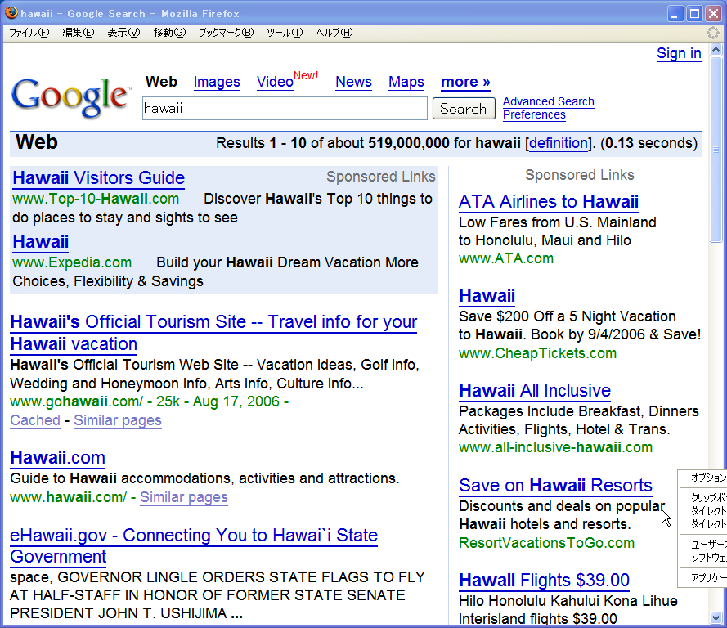
Sponsored Search
Notes:
The change was brought by Internet. In particular, sponsored search.
Here, I’m searching a keyword “Hawaii” by google.
I obtained search results here, but there are some more suspicious links also. They are advertisements.

Slide 32
Sponsored Search
Each advertiser bids a price for each keyword.
When the keyword is searched by a user, then the ads with top n bids are shown to the user (with a hyperlink to the advertiser’s page).
The advertiser needs to pay only when the user actually clicks the ad (pay-per-click).
Issue: how much should the advertiser pay?
Notes:
Each advertiser bids a price for each keyword.
When the keyword is searched by a user, then the ads with top n bids are shown to the user (with a hyperlink to the advertiser’s page).
This is an excellent idea. If the advertiser runs a TV commercial, it costs a lot of money. Also, the advertiser knows very little about who is watching the advertisement.
Here, in the sponsored search, it is rather obvious that who is searching the keyword “Hawaii”, is interested in Hawaii in some way.
Thus, the advertiser can run its advertisement targeted to the potential customers who are interested in its service.
Also, another good thing is that the advertiser needs to pay only when the user actually clicks the ad (pay-per-click).
In other words, the advertiser needs to pay money only when the advertisement is really effective and brings a customer to its home page.
However, there is one issue to be solved: how much should the advertiser pay?

Slide 33
Pricing Mechanism
In early systems, the advertiser pays the amount equal to its bid (i.e., first-price auction)
The advertiser keeps on sending a dummy search request, checks its position, and adjusts its price.
The bid prices keep on changing/unstable.
In recent systems (including Google), the advertiser, who wins the k-th slot, pays the price equal to the k+1-st bid (i.e., second-price).
The bid prices become more stable.
The most frequently used auction mechanism in the world!
Lessons Learned: for a mechanism, which is frequently used on the Internet by users including automated agents, having theoretical robustness is crucial.
Notes:
In early systems, the advertiser pays the amount equals to its bid, namely, the mechanism is the first-price auction.
Then, the advertiser keeps on sending a dummy search request, for example, if I’m bidding for a keyword “Hawaii”, I can submit a search request to google and check my position and adjust my price, namely, if I’m losing, I should increasing my bid. If I’m winning, I might be paying too much, so I try to reduce my bid, and so on.
If everybody doing so at the same time, the bid prices keep on changing and unstable.
This is very bad for google. So, in recent systems, the advertiser, who wins the k-th slot, pays the price equal to the k+1-st bid, namely, the mechanism is a natural extension of the Vickrey auction. As a result, the bid prices become more stable.
In principle, if somebody searches something using google, the Vickrey auction takes place. Which clearly means that, now, the Vickrey auction is the most frequently used auction mechanism in the world.
Here lessons learned is as follows: For a mechanism, which is frequently used on the Internet by users including automated agents, having theoretical robustness is crucial.

Slide 34
Combinatorial Auction
Multiple different goods with correlated values are auctioned simultaneously.
Complementary: PC and memory
Substitutable: VAIO or ThinkPad
Notes:
In a combinatorial auction, multiple different goods with correlated values are auctioned simultaneously.
The goods can be complementary, for example, a PC and a memory module. Without PC, a memory module would be useless, thus an agent wish to buy both at the same time.
On the other hand, the goods can be substitutable, for example, I want to buy a new PC, and it can be Dell or Gateway, but I don’t need them both. I only need one of them.
By allowing bids on any combinations of goods, the obtained social surplus and the revenue of the seller can increase.
In the United States, FCC, Federal Communications Commission, is now allocating spectrum rights using an auction. Clearly, spectrum rights of adjoining regions can be complementary. Thus, FCC spectrum auctions have become a major driving force for activating the theoretical research on combinatorial auctions.

Slide 35
Advantage of combinatorial auctions
When the value of goods are interdependent, the value of a good cannot be determined separately.
Without a PC, having memory modules is useless.
With VAIO, ThinkPad is useless.
By allowing bids on any combinations of goods, the bidder can safely/easily declare his/her values.
Notes:
In a combinatorial auction, multiple different goods with correlated values are auctioned simultaneously.
The goods can be complementary, for example, a PC and a memory module. Without PC, a memory module would be useless, thus an agent wish to buy both at the same time.
On the other hand, the goods can be substitutable, for example, I want to buy a new PC, and it can be Dell or Gateway, but I don’t need them both. I only need one of them.
By allowing bids on any combinations of goods, the obtained social surplus and the revenue of the seller can increase.
In the United States, FCC, Federal Communications Commission, is now allocating spectrum rights using an auction. Clearly, spectrum rights of adjoining regions can be complementary. Thus, FCC spectrum auctions have become a major driving force for activating the theoretical research on combinatorial auctions.

Slide 36
Applications of combinatorial auctions
Spectrum right auction conducted by Federal Communications Commission (FCC in US)
Assigning the slots of runways in an airport (an aircraft needs to take off after it lands)
Assigning truck delivery tasks
Procurement auctions
…

Slide 37
Research Issues in Combinatorial Auctions
Finding the best combination of bids is a complicated combinatorial optimization problem
Known as the winner determination problem, reduced from the set packing problem => NP-hard
Various search techniques and/or approximations are introduced
How to describe the preference of an agent is also a research issue -- 2^{m} subsets for m goods
Notes:
There are many research issues related to combinatorial auction.
Finding the best combination of bids is a complicated combinatorial optimization problem
winner determination problem, one instance of a set packing problem
NP-complete
Various search techniques are introduced
How to describe the preference of an agent is also a research issue --- 2^{m} subsets for m goods

Slide 38
Winner determination problem
For simplicity, assume one bidder bids only for a single bundle (a set of goods).
Example：
bidder A: $40 for (1, 2)
bidder B: $50 for (2, 3)
bidder C: $30 for (3)
bidder D: $60 for (1, 3)
bidder E: $10 for (1)
The auctioneer assigns the goods such that the social surplus (the sum of buyers’ bids) is maximized --- winner determination problem
In this case, making A and C as winners is optimal: the revenue is $70.
Notes:
On the other hand, || combinatorial auctions have the problem of winner determination.
The goal of such a problem is | to find a solution that maximizes the sum of bid prices.
It is a complicated constraint optimization problem | and can be formalized | as a weighted set packing problem | that has been shown to be NP-complete.
Some algorithms have been proposed for finding optimal solutions. They include algorithms based on the Iterative Deepening A* algorithm and depth-first branch-and-bound algorithm.
However, || we need to give up the idea of finding optimal solutions for very large-scale problems.

Slide 39
Difficulty of winner determination problem
Assume the number of bidders is n, then the number of possible combinations of winners becomes 2^{n}.
This problem is one instance of a weighted Set Packing problem.
This problem belongs to a problem class called NP-complete.

Slide 40
Combinatorial explosion
Assume the number of combinations to be checked is n to the power of 2. We use a computer that can check a hundred million combinations in one sec. Then, the required time is:
n= 20 : 1/100 sec.
n= 30 : 11 sec.
n= 40 : 3 hours
n= 50 : 130 days
n= 60 : 365 years
n= 70 : 370 thousand years
n= 80 : 4 hundred million years
…

Slide 41
Search tree
Each node in a tree represents a bid.
Choose whether to make the bidder as a winner (IN) or not (OUT).
A: (1, 2)
B: (2, 3)
C: (3)
D: (1, 3)
A
IN
OUT
C
B
IN
OUT
IN
OUT
C
OUT
IN
D

Slide 42
Pruning search tree
For a large-scale problem, exploring the whole search tree is impossible.
Is it possible to obtain an optimal solution just by checking a part of the tree?
Pruning is possible if we can obtain an optimistic evaluation about the possible solutions obtained in a sub-tree. -- Branch & Bound

Slide 43
Branch & Bound
A: (1, 2)=40
B: (2, 3)=50
C: (3)=30
D: (1, 3)=60
A
IN
OUT
C
If we know the obtained solution in this branch is at most 60, we can prune the tree.
IN
OUT
70
40

Slide 44
Finding an optimistic estimation
We can use a linear programming to efficiently solve the problem
However, we cannot obtain an integer solution; the solution says that two bidders must share a good A in a half (which is not possible).
A linear programming solves a relaxed problem (which ignores integer constraints), thus the obtained solution must be at least as good as an optimal solution of the original problem.

Slide 45
Heuristics for efficiency
The order of bids matters.
The larger one is better (more influential to others).
The order of IN/OUT also matters.
Finding a good solution earlier is good in Branch & Bound.
Check the solution obtained by a linear programming (choose the better one first).
A
IN
OUT
C
B
IN
OUT
IN
OUT

Slide 46
Problem size that can be solved
A specialized algorithm (CABOB, Sandholm, et al., 2001) can solve problem instances with 400 goods, 4,000 bids in a less than a few seconds.
A commercial integer programming package (linear programming + integer constraints, e.g., CPLEX or Gurobi) is also quite efficient.

Slide 47
Vickrey-Clarke-Groves Mechanism – VCG
Each agent declares its evaluation values for subsets of goods.
The goods are allocated so that the social surplus is maximized.
The payment of agent 1 is equal to the decrease of the social surplus except agent 1, caused by the participation of agent 1.
Satisfies incentive compatibility (strategyproofness) and Pareto efficiency.
Notes:
Now, let me describe the generalized Vickrey auction mechanism, GVA. As its name shows, the GVA is a generalized version of the Vickrey auction.
It can be used for combinatorial auctions of multiple goods with correlated values, such as the spectrum rights auctioned by the Federal Communications Commission.
In the GVA, the goods are allocated so that the social surplus, namely, the sum of the utilities of all agents, is maximized.
The payment of agent 1 is equal to the decrease of the social surplus except agent 1, caused by the participation of agent 1.
The GVA satisfies incentive compatibility and Pareto efficiency if there exists no false-name bid.

Slide 48
Example of VCG
Setting: three agents (agent 1, 2, 3) are bidding for two goods.
Result:
Agent 1 gets the coffee, 3 gets the cake.
Agent 1 pays $8－$5＝$3.
Agent 3 pays $8－$6＝$2.

Slide 49
Incentive Compatibility of VCG
Goods are allocated so that social surplus is maximized.
An agent can maximize its utility when the social surplus is maximized.
social surplus when 1 does not participate ($8)
1’s utility ($3)
1’s payment ($3)
1’s evaluation value ($6)
social surplus except 1 when 1 does participate ($5)
Social Surplus ($11)
Notes:
The VCG satisfies | incentive compatibility. That is, telling the true evaluation value is the optimal strategy.
In the VCG, the goods are allocated so that the social surplus is maximized. In general, maximizing the social surplus does not necessarily mean maximizing each agent’s utility. Therefore, each agent might have an incentive for lying.
However, in the VCG, each agent can maximize its utility when the social surplus is maximized. Therefore, any agent does not have an incentive for lying. I’m going to explain why this is possible.
This green line shows the social surplus | when “A” does not participate, which is equal to $8 in the previous example.
This shows the social surplus when “A” does participate. With A’s participation, the social surplus except “A” decreases to $5.
Therefore,“A”’s payment is defined as the difference between the green line and the yellow line, namely, $3.
Then, “A” ’s utility is the difference between the total length of the bottom line and the green line, since its utility is defined as the difference between its evaluation value and its payment. “A” can maximize its utility as a result of maximizing the length of the bottom since the length of the green line is defined independent of “A”’s declaration. But actually, the bottom represents the social surplus.
Therefore, “A” can maximize its utility when the social surplus is maximized. As a result, the VCG satisfies | incentive compatibility.

Slide 50
Quiz: VCG Payment
4 bidders, two goods
 | coffee | cake | both
Bidder 1 | $6 | $0 | $6
Bidder 2 | $0 | $0 | $8
Bidder 3 | $0 | $5 | $5
Bidder 4 | $3 | $1 | $5
Show the winners and their payments
Notes:
具体例を示します．
三人の参加者が，２つの商品，この場合はコーヒーとケーキのオークションに参加しているとします．
agent1という参加者は，コーヒーは$6だけど，甘い物はきらいなのでケーキは$0，コーヒーとケーキを両方もらっても$6という入札をしているとします．
一方，agent2という参加者は，ケーキを食べるときには絶対コーヒーが欲しくて，両方なら$8払っても良いけど，片方だけならいらない，$0という入札をしているとします．
agent3という参加者は，agent1の逆で，ケーキは好きだけどコーヒーはきらい，ケーキだけなら$6で，コーヒはいらないという入札をしているとします．
この場合，社会的余剰，世の中の幸せを最大化する割り当て方法は，agent1にコーヒーを，agent2にケーキを割り当てることで，社会的余剰は$6+$6=$12となります．
で，agent1の支払額はどのように計算されるかというと，agent1が，入札に参加することの迷惑料，他の参加者の効用の減少分を計算します．
もしagent1が参加しなかったとすると，社会的余剰を最大化する割り当ては，agent2に両方の財を割り当てる方法で，社会的余剰は$8です．一方，agent1が参加した場合には，もう一人のagent3にケーキが割り当てられて，agent1以外の効用は$6です．
よって，agent1が参加することによって，他の参加者の効用は$8から$6に減少したことになり，agent1はこの減少分，$8-$6=$2を支払うことになります．
agent3の支払額も全く同様に計算できます．

Slide 51
Quiz: Clarke Tax
VCG can be used for more general setting in group decision making
Example: determine whether to extend this lecture 60 minutes, i.e., 180mins in total.
You declare your monetary value for the choice (e.g., for extending, $20, -$100, etc., assuming that not change is $0)
How can we guarantee that you will declare your true preference?
Notes:
VCG can be used for more general setting in group decision making
Let us consider an example. Assume we need to determine whether to extend this class 60 minutes.
You declare your monetary value for the choice (e.g., for extending, $20, -$100, etc., assuming not change is $0)
How can we guarantee that you will declare your true preference?
If you truthfully declare your preference, if the sum of values is positive, it is better to extend. Otherwise, it is better not to extend. However, by just taking the sum, you have an incentive to misreport. If your value is just $10 dollars, you can say it is $1000. Also, even if your value is -$1, you can say it is -$1000 to make sure the lecture will not be extended.

Slide 52
Answer
Calculate the sum.
If the sum is positive, we extend the class.
If your bid changes the outcome, you are charged the minimum amount needed to change the outcome.
agent 1: $20, agent 2: -$10, agent 3: -$20, agent 4: $35
The result is to extend, the payments are:
agent 1: $0, agent 2: $0, agent 3: $0, agent 4: $10
Notes:
The idea of applying VCG is as follows.
We calculate the sum. If the sum is positive, we extend the class.
To make sure you have an incentive for truth-telling, we sometimes impose a payment called Clarke tax.
More specifically, if your vote changes the outcome, you are charged the minimum amount needed to change the outcome.
agent 1: $20, agent 2: -$10, agent 3: -$20, agent 4: $30
The result is to extend, the payments are:
agent 1: $0, agent 2: $0, agent 3: $0, agent 4: $10
Note: the money collected must be thrown away (cannot simply share among participants)

Slide 53
Note for Clarke tax
The money collected must be thrown away, e.g., we cannot simply divide the amount among participants.
Increasing the tax for other participants is profitable, violating incentive compatibility
In auctions, the amount is taken by the auctioneer; thus we do not need to care this issue.

Slide 54
Limitations of VCG
VCG can be used for mechanism design in general. It is theoretically well-founded.
satisfies (dominant-strategy) incentive compatibility and achieves Pareto efficiency in a dominant strategy equilibrium
However, it has several limitations
Computationally expensive (NP-hard), the outcome is not in the core, vulnerable against the collusion of losers, …
We still need to design new mechanisms for each application domain.
Notes:
The VCG can be used for mechanism design in general. It has theoretically well-founded.
Namely, it satisfies dominant-strategy incentive compatibility, achieves Pareto efficient allocation in a dominant strategy equilibrium.
However, it has several limitations.
First, it is computationally expensive (NP-hard), the outcome is not in the core, vulnerable against the collusion of losers, vulnerable against false-name bids.
It cannot guarantee budget balance/non-negative in more general settings (apart from auctions).
Thus, VCG is not always a right solution. We still need to design new mechanism for each application domain.

Slide 55
Matching (One-to-One and Many-to-One)

Slide 56
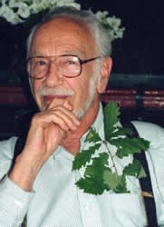
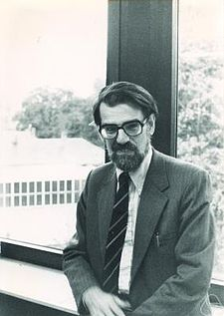
Two-sided Matching
The goal is to find a desirable combination of two parties: students ⇔ laboratories or schools, workers ⇔ companies, medical residents ⇔ hospitals
The Deferred Acceptance (DA) mechanism (a.k.a., Gale-Shapley mechanism) is well-known.
It is called a stable marriage problem when the matching is one-to-one.
3/10
Notes:
Here, the goal is to find a desirable combination of two parties, such as students and laboratories or schools, or workers to companies, or medical residents to hospitals.
The deferred acceptance mechanism, which is also known as Gale-Shapley mechanism is well-known.
It is called a stable marriage problem when the matching is one-to-one.

Slide 57
Stable marriage problem
Assume there are three males and three females.
Each male has his own strict preference order among three females, and each female has her own strict preference order among three males.
We want to create three pairs, so that there exists no “blocking pair” = a matching that satisfies the stability constraint (as well as the incentive constraint).
Notes:
So, what is a stable marriage problem?
Assume there are three males and three females.
Each male has his own strict preference order among three females. And each female has her own strict preference order among three males.
Here, we want to create three pairs, so that there exists no blocking pair.

Slide 58




Blocking pair (review)
K A
J B
Female：Alice, Becky, Carol
Male：John, Ken, Lee
For Alice, J ≻ K ≻ …
For John, A ≻ B ≻ …
If Alice is paired with Ken, and John is paired with Becky, Alice and John would be happier if they break the current pairs and create a new pair.
Such a pair is called a blocking pair.
A matching called stable if it does not contain a blocking pair.
Notes:
Then, what is a blocking pair?
Assume there are three females, Alice, Becky, and Carol.
And three males, John, Ken, and Lee.
Assume Alice prefers John over Ken,
And John prefers Alice over Ken.
Then, if Alice is paired with Ken, and John is paired with Becky, Alice and John would be happier if they break current pairs and create a new pair.
Such a pair is called a blocking pair.
A matching is called stable if its does not contain a blocking pair.

Slide 59
Finding a stable matching: deferred acceptance (DA)
Each male/female is either single or engaged (initially, everybody is single).
As long as any single female remains, repeatedly apply the following round:
A single female proposes to her most preferred male, to whom she has not proposed (and rejected) before (does not care whether he is single or engaged).
A male engages with the most preferred female who proposes to him; if a new female, who is better than his fiancée, is proposing to him, he breaks the current engagement and engages with the new female.
When no single female remains, the current engagements become the final matching.
Notes:
Let me describe the mechanism for finding a stable matching, which is called a deferred acceptance (DA) mechanism.
Each male/female is either single or engaged. Initially, everybody is single.
As long as any single female remains, repeatedly apply the following round.
A single female proposes to her most preferred male, to whom she has not proposed and rejected before. She does not care whether he is single or engaged.
Then, a male engages with the most preferred female who proposes to him. If a new female, who is better than his finacee, is proposing, then he breaks the current engagement and engages with the new female.
When no single female remains, the current engagements become the final matching.

Slide 60
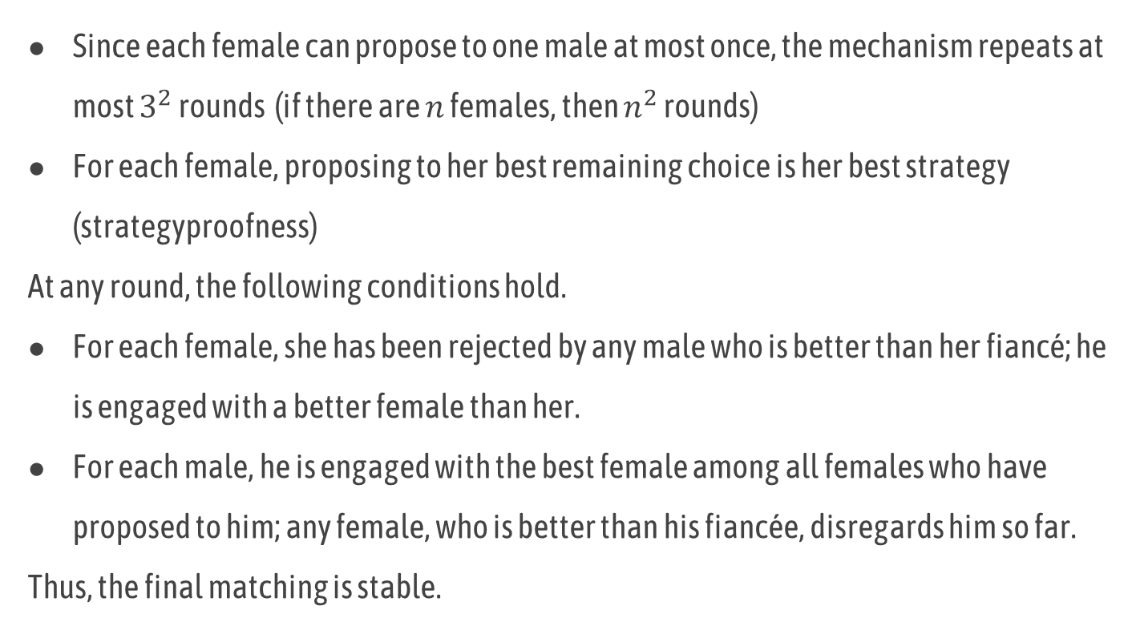
Characteristics of DA (I) : Stability
Since each female can propose to one male at most once, the mechanism repeats at most $3^{2}$ rounds (if there are $n$ females, then $n^{2}$ rounds)
For each female, proposing to her best remaining choice is her best strategy (strategyproofness)
At any round, the following conditions hold.
For each female, she has been rejected by any male who is better than her fiancé; he is engaged with a better female than her.
For each male, he is engaged with the best female among all females who have proposed to him; any female, who is better than his fiancée, disregards him so far.
Thus, the final matching is stable.
Notes:
Let me describe the characteristics of DA.
Since each female can propose to one male at most once, the mechanism repeats at most 3 square rounds. If there are n females, then n square rounds.
For each female, proposing to her best remaining choice is her best strategy, i.e., the mechanism is strategyproof for females.
Also, at any round, the following conditions hold.
For each female, she has been rejected by any male who is better than her fiancé, namely, he is engaged with a better female than her.
For each male, he is engaged with the best female among all females who have proposed to him. i.e., any female, who is better than his fiancée, disregards him so far.
Thus, there is no blocking pair and the final matching is stable.

Slide 61



Characteristics of DA (II) : Incentive of Males
For each female, proposing to her most preferred male (who has not rejected her yet) is her optimal strategy (strategyproofness).
The obtained matching is optimal for females among all stable matchings.
Is this mechanism strategyproof for males? Assume for J: A ≻ B ≻ C, B and C are proposing to J. A is proposing to K. For K: B ≻ A, for A: K ≻ J, for B: J ≻ K.
Assume if J chooses B, the matching is finalized. If J chooses C, B proposes to K, then A is rejected and now proposes to J!
There exists no mechanism that is strategyproof for both males and females.
K A
J B

Slide 62
Quiz: Collusion in DA mechanism
Discuss whether a group of females can collude and obtain a better matching in DA.
Hint: consider the following two separate cases:
Each member in the group obtains a strictly better matching (compared to truth-telling).
Some members obtain better matchings, while the other members are the same (as the truth-telling).

Slide 63
Precaution for Applying Game Theory in Real Application (I)
Game theory is math; if we accept its model/assumptions, its predictions are logically correct.
However, we need to check whether the model/assumptions are appropriate or not in a real application.
Assume a hundred males/females are invited to a party to create 100 pairs using the DA.
The logical predictions are that the obtained matching is stable and honesty is the best policy for a female.
Can we believe them? Is there any problematic assumption that is not likely to hold?

Slide 64
Precaution for Applying Game Theory in Real Application (II)
Assumption: a male has a predefined, static, complete ordering among females and his choice is based on this ordering.
Let us assume you are a male and consider the following situation.
Initially, you prefer Alice over Becky (very slightly).
Becky proposes to you at the first round.
Nobody except Becky proposes to you before the 99th round.
In the 99th round, Alice proposes to you (since she has been rejected by other 98 males).
Are you going to choose Alice over Becky?

Slide 65
Many-to-one matching
When matching students ⇔ laboratories, multiple students can be matched to the same laboratory.
We can apply an extension of the DA mechanism.
Each student corresponds to a female, and each laboratory corresponds to a male.
A laboratory can (tentatively) accept students up to its capacity limit/maximum quota.
Notes:
When matching students to laboratories, multiple students can be matched to the same laboratory.
We can apply an extension of the DA mechanism.
Here, each student corresponds to a female, and each laboratory corresponds to a male.
A laboratory can tentatively accept students up to its capacity limit called the maximum quota.

Slide 66
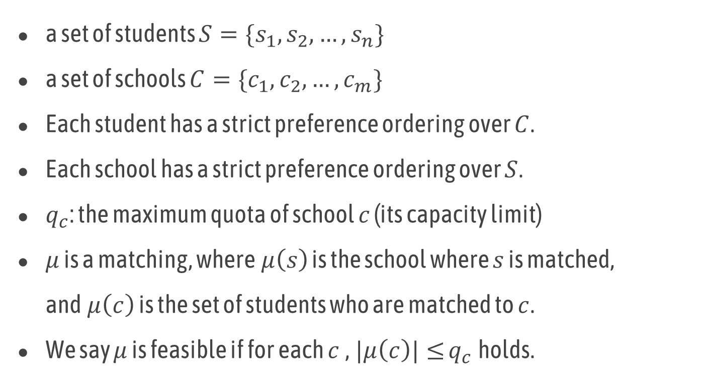
Basic Model
a set of students $S=\{s_{1},s_{2}, …,s_{n}\}$
a set of schools $C=\{c_{1},c_{2}, …,c_{m}\}$
Each student has a strict preference ordering over $C$.
Each school has a strict preference ordering over $S$.
$q_{c}$: the maximum quota of school $c$ (its capacity limit)
$μ$ is a matching, where$μ\left(s\right)$ is the school where $s$ is matched, and$μ\left(c\right)$ is the set of students who are matched to $c$.
We say $μ$ is feasible if for each $c$,$|μ\left(c\right)|≤$ $q_{c}$holds.
Notes:
There exists a set of students S, and a set of schools (or colleges) C.
Each student has a strict preference ordering over C, and each school has a strict preference ordering over S.
We assume \mu represents a matching. \mu s is the school where student s is assigned, and \mu c is the set of students assigned to school c.
This model is quite standard so far.
Now, I’m going to introduce non-standard concepts.
Let us assume vi: \mu represents an allocation vector, that describes the number of students allocated to each school.
A function \eta takes a vector of m natural numbers, where m is the number of schools, and returns zero or minus infinity. It represents distributional constraints, namely, matching \mu is feasible if \eta vi: \mu is equal to zero.

Slide 67
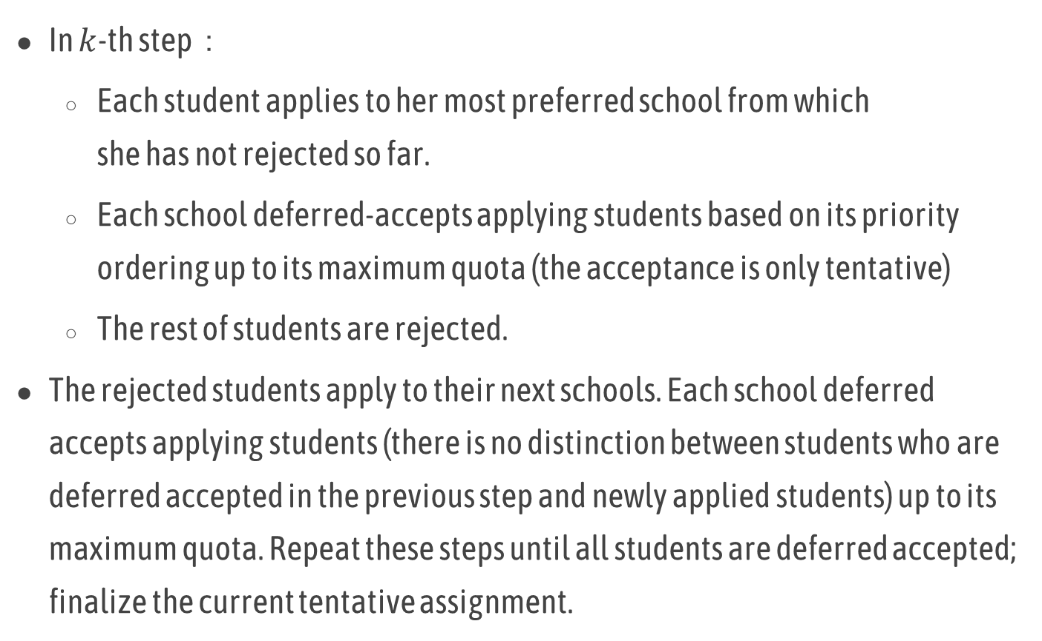
DA Mechanism for Many-to-One Matching
In $k$-th step：
Each student applies to her most preferred school from which she has not rejected so far.
Each school deferred-accepts applying students based on its priority ordering up to its maximum quota (the acceptance is only tentative)
The rest of students are rejected.
The rejected students apply to their next schools. Each school deferred accepts applying students (there is no distinction between students who are deferred accepted in the previous step and newly applied students) up to its maximum quota. Repeat these steps until all students are deferred accepted; finalize the current tentative assignment.

Slide 68


Application of DA mechanism
Y
T
S
Y
Y
S
T
Max 2
T
Y
S
T
Max 2
Y
S
T
S
Max 1
S
T
Y

Slide 69
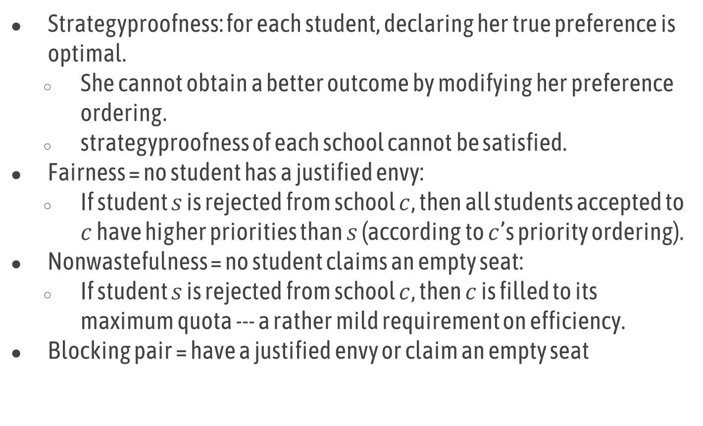
Characteristics of DA Mechanism (I)
Strategyproofness: for each student, declaring her true preference is optimal.
She cannot obtain a better outcome by modifying her preference ordering.
strategyproofness of each school cannot be satisfied.
Fairness = no student has a justified envy:
If student $s$ is rejected from school $c$, then all students accepted to $c$ have higher priorities than $s$ (according to $c$’s priority ordering).
Nonwastefulness = no student claims an empty seat:
If student $s$ is rejected from school $c$, then $c$ is filled to its maximum quota --- a rather mild requirement on efficiency.
Blocking pair = have a justified envy or claim an empty seat

Slide 70
Characteristics of DA Mechanism (II)
Fairness + Nonwastefulness＝ Stability
The DA mechanism obtains the optimal matching for students within all stable matchings (within all stable matchings, all students prefers the matching obtained by the DA mechanism, including ties).
However, the DA mechanism cannot satisfy individual minimum quotas or regional maximum quotas.
By introducing these constraints, there is a chance that there exists no stable matching.

Slide 71
Why constraints matter?
It is common that social requirements impose various distributional constraints on the outcome of the matching.
A school needs a certain number of students to operate.
Some medical residents must be assigned to a rural hospital.
Is it really reasonable to assume each school has a strict, exogenously given maximal quota?
We usually have some flexibility (e.g., allocating more human resources to popular schools).
Such flexibility can be naturally represented by constraints!

Slide 72
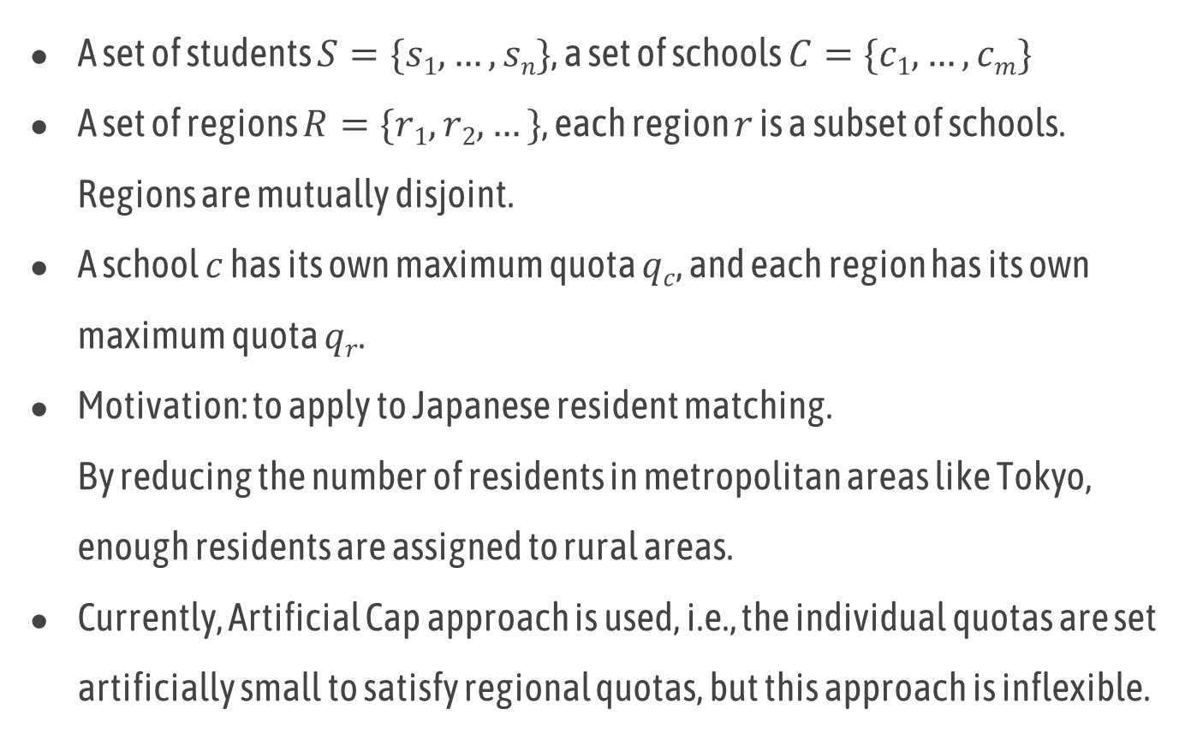
Model with Regional Maximum Quotas (Kamada & Kojima 2015）
A set of students $S=\{s1, …, sn\}$, a set of schools $C=\{c1, …,cm\}$
A set of regions $R=\{r1, r2, …\}$, each region $r$ is a subset of schools. Regions are mutually disjoint.
A school $c$ has its own maximum quota $qc$, and each region has its own maximum quota $qr$.
Motivation: to apply to Japanese resident matching. By reducing the number of residents in metropolitan areas like Tokyo, enough residents are assigned to rural areas.
Currently, Artificial Cap approach is used, i.e., the individual quotas are set artificially small to satisfy regional quotas, but this approach is inflexible.

Slide 73
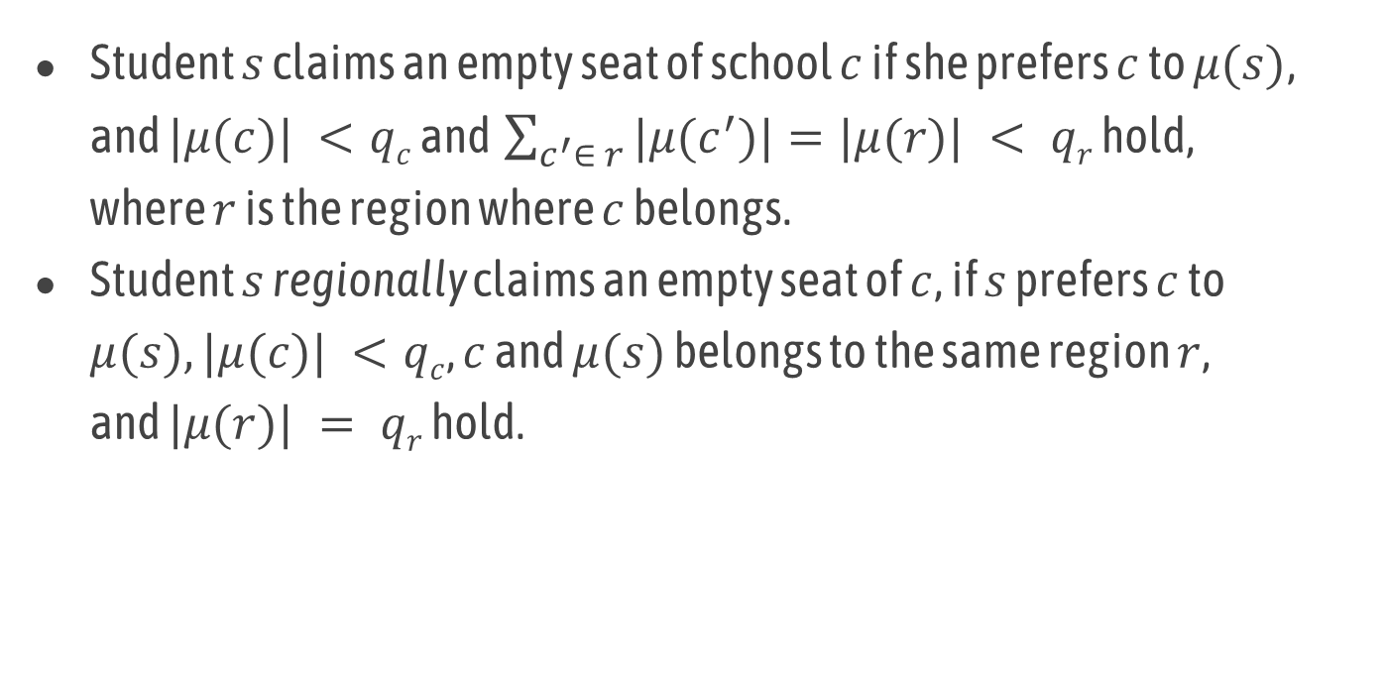
Claim an Empty Seat (with Regional Maximum Quotas)
Student $s$ claims an empty seat of school $c$ if she prefers $c$ to $μ(s)$, and $|μ(c)| <qc$ and $\sum_{c^{′}∈ r}{|μ(c^{′})|}=|μ(r)| < qr$ hold, where $r$ is the region where $c$ belongs.
Student $s$ regionally claims an empty seat of $c$, if $s$ prefers $c$ to $μ(s), |μ(c)| <qc$, $c$ and $μ(s)$ belongs to the same region $r$, and $|μ(r)| = qr$ hold.

Slide 74
Effect of regional maximum quotas
There exists an instance where no matching satisfies fairness and nonwastefulness (including regional nonwastefulness) simultaneous.
Thus, we need to give up one of them.
In general, there exists a trade-off between fairness and efficiency (the welfare/satisfaction of students).
Nonwastefulness is one criterion for students’ welfare.

Slide 75
Quiz: regional maximum quotas
Show that fairness and nonwastefulness (including regional nonwastefulness) are incompatible with regional maximum quotas.
Hint: show a (small) problem instance where a matching satisfying both properties does not exist.

Slide 76
Answer (an example where no matching exists)
Two students A and B, and two schools 1 and 2
Schools 1 and 2 are in a same region R
Preferences of students … A: 1>2, B: 2>1
Preferences of schools … 1: B>A, 2: A>B
Individual Max Quotas … q1 = q2 = 1
Regional Maximum Quota … qR = 1
A-1 match => B has a justified envy toward A, since 1: B > A
A-2 match => A regionally claims an empty seat of school 1

Slide 77


Flexible DA Mechanism (Kamada & Kojima 2015)
Apply the following procedure in each step in DA.
Assume a round-robin ordering among schools within a region is defined (e.g., c₁→c₂→c₁→…).
According to this ordering, each school deferred-accepts one student as long as doing so does not violate individual/regional maximum quotas. Otherwise, all remaining students applying to the school are rejected.
Regional Max: 4
1
２
３
４
5
A
B
c₁ ≻ c₃ ≻ c₂
c₁
c₂
c₃
C
c₂ ≻ c₁ ≻ c₃
D
E
Notes:
そこで拡張枠の割り当て方を変更した新しいメカニズムnewESDAを提案します．
newESDAでは拡張枠の割り当てに学生のマスターリストは使わず学校のマスターリストmlsを使います．
拡張枠に申し込むところまでは先ほどと同じです．
学校は拡張枠に申し込んだ学生を選好順に並び替えます．
そして学校のマスターリスト順に１人ずつ割り当てていきます．
まずs1にこの子を割り当てます．次にs2にこの子を割り当てます．拡張枠全体の上限が２なのでdさんがはじかれます．
dさんがs3に申し込み割り当てが終了します．
このメカニズムではブロッキングペアが発生しません．

Slide 78
Characteristics of Flexible DA
Strategyproof and fair
No student claims an empty seat, but there is a chance that a student regionally claims an empty seat.
More flexible than the artificial cap approach
more students can be assigned to a popular school
The obtained matching is optimal within all matchings that satisfy some stability requirement (called Hatfield-Milgrom stability), but the definition is complicated and not very intuitive.

Slide 79
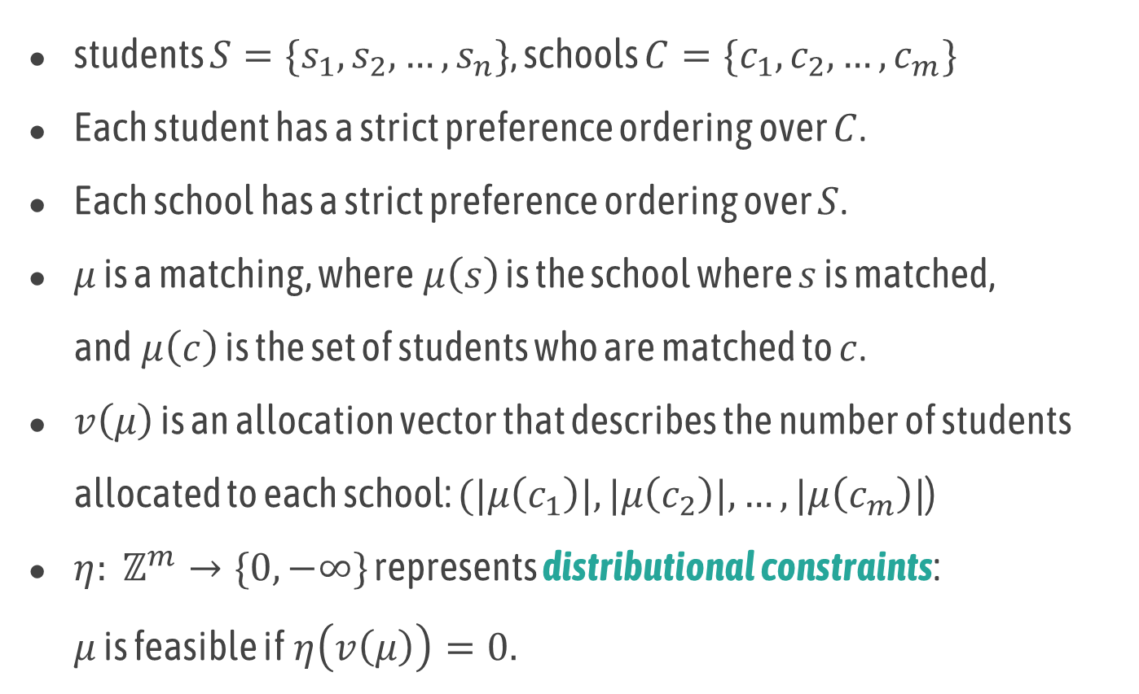
Handling more general constraints
students $S=\{s_{1},s_{2}, …,s_{n}\}$, schools $C=\{c_{1},c_{2}, …,c_{m}\}$
Each student has a strict preference ordering over $C$.
Each school has a strict preference ordering over $S$.
$μ$ is a matching, where$μ\left(s\right)$ is the school where $s$ is matched, and$μ\left(c\right)$ is the set of students who are matched to $c$.
$v\left(μ\right)$ is an allocation vector that describes the number of students allocated to each school: $(|μ\left(c_{1}\right)|,|μ\left(c_{2}\right)|, …,|μ\left(c_{m}\right)|$)
$η: ℤ^{m}→\{0, −∞\}$ represents distributional constraints: $μ$ is feasible if$η\left(v\left(μ\right)\right)=0.$
Notes:
In a generalized model, as the basic model,
There exists a set of students, and a set of schools, and their preferences.
Also, we assume \mu represents a matching.
To represent distributional constraints,
Let us assume vi: \mu represents an allocation vector, that describes the number of students allocated to each school.
A function \eta takes a vector of m natural numbers, where m is the number of schools, and returns zero or minus infinity. It represents distributional constraints, namely, matching \mu is feasible if \eta vi: \mu is equal to zero.

Slide 80





Distributional constraints
In a standard model, only constraints are individual maximum quotas.
Then, feasible vectors form a hyper-rectangle.
maximum quota: 3
：feasible vector
allocation vector: $\left( 3 , 2 \right)$
$$c_{2}$$
$$c_{1}$$
4 3 2 1 0
$$c_{2}$$
0 1 2 3 4
$$c_{1}$$
Notes:
In a standard model, only constraints are individual maximum quotas. Then, feasible vectors form a hyper-rectangle.
For example, if there are two schools, and three students are allocated to c1, and two students are allocated to c2, then the allocation vector of this matching is (3, 2).
If the maximum quotas of these schools are three, feasible vectors form this rectangle.

Slide 81





Distributional constraints
Heredity: if vector $v$ is feasible, then any vector smaller than $v$ is also feasible.
M♮-convex set: no hollow
hereditary, not M♮-convex set
hereditary and M♮-convex set
$$c_{2}$$
$$c_{2}$$
5 4 3 2 1 0
5 4 3 2 1 0
0 1 2 3 4 5
$$c_{1}$$
0 1 2 3 4 5
$$c_{1}$$
Notes:
In the framework of Kojima, Tamura, and Yokoo, it is assumed that feasible vectors are hereditary and form an M-natural-convex set.
Heredity means if vector vi: is feasible, then any vector that is smaller than vi: is also feasible.
Intuitively, an M-natural-convex set means there exists no hollow.
This example is hereditary and forms an M-natural convex set.
This example is hereditary, but does not form an M-natural convex set.

Slide 82
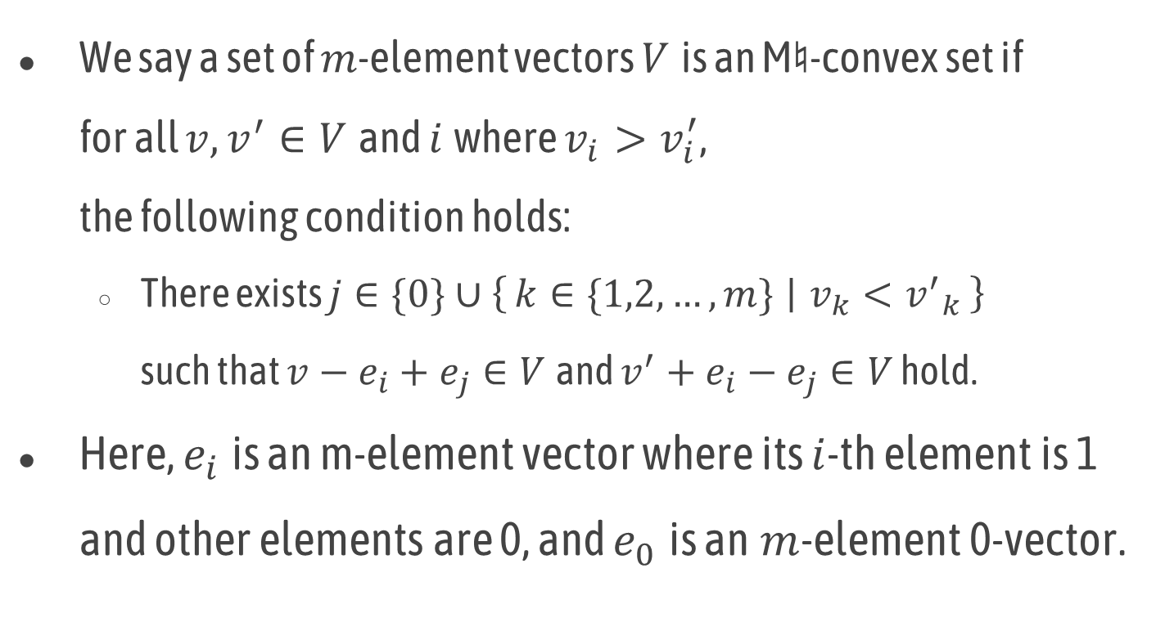
M♮-convex set
We say a set of $m$-element vectors $V$is an M♮-convex set if for all $v,v^{′}∈V$and $i$where $v_{i}>v_{i}^{′}$, the following condition holds:
There exists $j∈\{0\}∪\left\{k∈\{1,2,…,m\} ∣ v_{k}<{v^{′}}_{k}\right\}$ such that $v−e_{i}+e_{j}∈V$and $v^{′}+e_{i}−e_{j}∈V$ hold.
Here, $e_{i}$is an m-element vector where its $i$-th element is 1 and other elements are 0, and $e_{0} \text{is} \text{an} m$-element 0-vector.

Slide 83
Constraints satisfying M♮-convexity
Reginal maximum/minimum quotas
Each region (as well as each individual college) has its minimum and maximum quotas.
Affirmative actions with soft minimum quotas
Students are divided into different types and soft minimum quotas are specified to each type
Distance constraints:
Any matching that is “close enough” to an ideal distribution is acceptable.
…
Notes:
Constraints that satisfies M-natural-convexity includes regional maximum minimum quotas, where each region, as well as individual colleges has its minimum and maximum quotas.
and affirmative actions with soft minimum quotas, where students are divided into different types and soft minimum quotas are specified to each type.

Slide 84






Constraints violating M♮-convexity
Project-student-room assignment problem:
Assign students and a room to each project
The maximum quota of a project is determined by the size of the allocated room
$$c_{2}$$
5 4 3 2 1 0
Room B
$$c_{1}$$
$$c_{2}$$
Room A
0 1 2 3 4 5
$$c_{1}$$
Notes:
Let me describe an example where constraints violate M-natural-convexity.
In a project-student-room allocation problem, we need to assign students and a room to each project.
The maximum quota of a project is determined by the size of the allocated room. If there are two projects and two rooms, and one room can accommodate only one student, while the other room can accommodate four students, the feasible vectors form this shape and this is not an M-natural-convex set.

Slide 85
Handling more general constraints
Which class of constraints can the (generalized) DA handle?
Answer: hereditary and M♮-convex set (Kojima, Tamura, & Yokoo, Journal of Economic Theory, 2018)
Is it possible to handle any broader class of constraints?
Answer: Yes, by Adaptive DA (Goto, Kojima, Kurata, Tamura, & Yokoo, American Economic Journal: Microeconomics, 2016)
Notes:
We show that the regional maximum quota can be handled by the generalized or modified DA.
Then, the next question is which class of constraints can the generalized DA handle.
The answer is that, if the constraints is hereditary and can be represented as M-natural convex set, then the generalized DA works fine.
Another question is that, is it possible to handle any broader class of constraints.
The answer is Yes, by a mechanism called adaptive DA.

Slide 86
Top Trading Cycle Mechanism (Shapley and Scarf 1974) -- for achieving Pareto efficient matching
First assign males to females randomly.
Then, each female points to the female who is matched to her most preferred male (she can point to herself).
There must be at least one cycle. Females in the cycle exchange males accordingly and leave the market. The rest of females repeat the same procedure until nobody remains.

Slide 87
Example (TTC)
 | Alice | Becky | Carol
first | John | John | Lee
second | Ken | Lee | John
third | Lee | Ken | Ken
Notes:
Let me show an example.
Here, each female proposes her most favorite male.
Then, Alice and Becky conflict.
According to John’s preference, Becky is rejected.

Slide 88
Characteristics of TTC
Strategyproof
If there exists a path pointing you, you can obtain any objects/males in the path.
The path remains as long as you stay in the market; you can get them anytime, so you don’t need to choose any of them if they are not your first choice.
Pareto efficient
In the first cycle, all females obtain their first choices.
In the second cycle, if some female obtains her second best, her outcome cannot be improved without worsening some female in the first cycle, and so on.

Slide 89
Applying TTC to Two-sided Matching
Mechanism:
Each student points to her most preferred school.
Each school points to its most preferred student.
There must be at least one cycle.
Each student in the cycle obtains a seat of the school she is pointing and leaves the market. If a school has no remaining seats, it also leaves the market.
Repeat the procedure for the rest of students and schools.

Slide 90
Summary

Slide 91
Summary
Basics of Game Theory and Mechanism Design
Dominant Strategy Equilibrium
Auction
Second-Price (Vickrey) – Strategy-proof single-item auction
VCG – Strategy-proof combinatorial auction, but computationally expensive
Matching
Deferred Acceptance (DA) – Strategy-proof and fair, but cannot handle distributional constraints
Flexible DA – strategy-proof and fair for regional maximum quotas
Top-Trading-Cycles – Strategy-proof and Pareto efficient

